Slide 1


MAP Lab
LAB 3 : Use Push Button to Control LED
Kshitij Hemant Gurjar (SY M.Tech VLSI)
Prof. Y.M. Vaidya
Swapnil Phalke (SY M.Tech VLSI)
MAP Lab

Slide 2
AIM
In this tutorial, we will learn how to use on-board Push buttons of TM4C123G TIVA launchpad to control onboard LEDs. Firstly, you should know how to use GPIO pins of TM4C123G6PM microcontroller as digital output pins
LAB 1 Introduction to TM4C123
Kshitij Hemant Gurjar (SY M.Tech VLSI)
Prof. Y.M. Vaidya
Swapnil Phalke (SY M.Tech VLSI)
MAP Lab

Slide 3
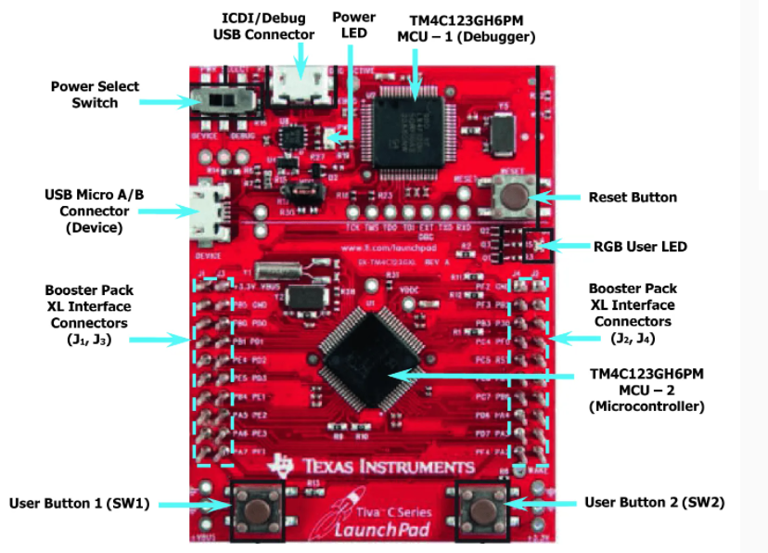
Kshitij Hemant Gurjar (SY M.Tech VLSI)
Prof. Y.M. Vaidya
Swapnil Phalke (SY M.Tech VLSI)
MAP Lab

Slide 4
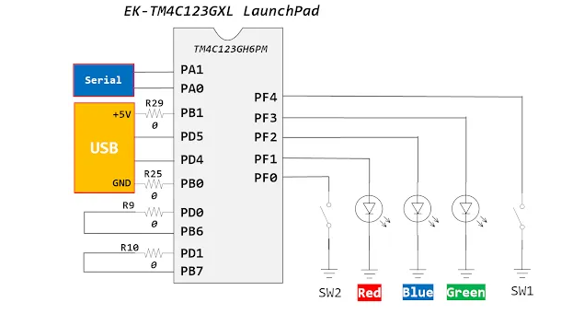
Kshitij Hemant Gurjar (SY M.Tech VLSI)
Prof. Y.M. Vaidya
Swapnil Phalke (SY M.Tech VLSI)
MAP Lab

Slide 5
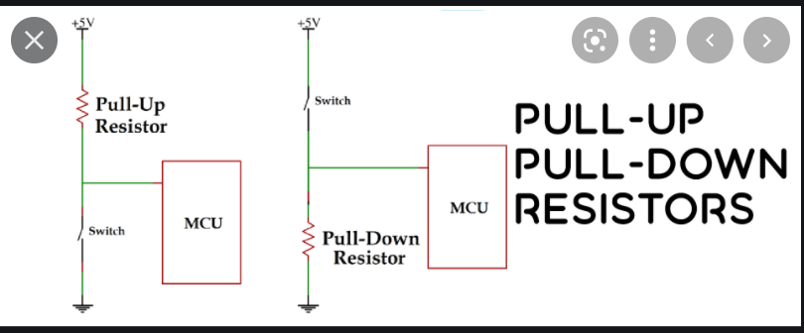
There is no pull-up resistor available with switch-one and switch-two. But the good thing is that the TM4C1235G series microcontroller has internal pull-up and pull-down registers associated with each port. We can configure these resistors using a respective GPIO port register. In the programming section, we will see how to configure this register.
Kshitij Hemant Gurjar (SY M.Tech VLSI)
Prof. Y.M. Vaidya
Swapnil Phalke (SY M.Tech VLSI)
MAP Lab

Slide 6
Mechanical switches are commonly used to feed any parameters to the digital systems. The switches can be interfaced to a microcontroller using digital inputs. The software program for switch interfacing can be implemented using one of the following methods. 1. Polling based method
2. Interrupt based method
We will discuss polling based switch interfacing in this tutorial. Before proceeding further, it is important to first make ourselves familiar with the physical behavior of switch and be will describe switch bouncing next, which is one of the critical attribute of its physical behavior
Kshitij Hemant Gurjar (SY M.Tech VLSI)
Prof. Y.M. Vaidya
Swapnil Phalke (SY M.Tech VLSI)
MAP Lab

Slide 7
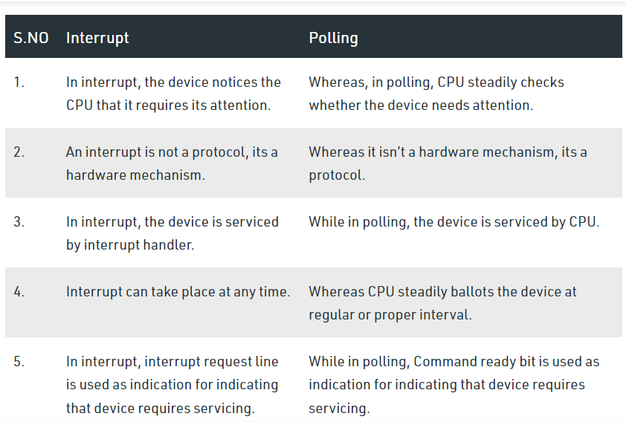
Kshitij Hemant Gurjar (SY M.Tech VLSI)
Prof. Y.M. Vaidya
Swapnil Phalke (SY M.Tech VLSI)
MAP Lab

Slide 8
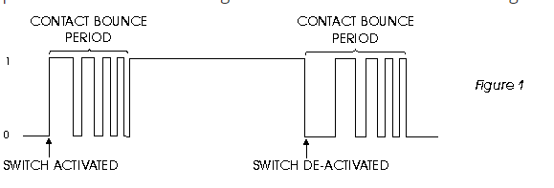
Switch bouncing
Kshitij Hemant Gurjar (SY M.Tech VLSI)
Prof. Y.M. Vaidya
Swapnil Phalke (SY M.Tech VLSI)
MAP Lab

Slide 9
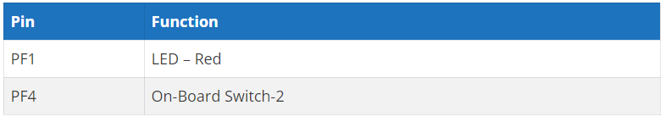
Controlling an LED with a push button using Tiva Launchpad
whenever a user presses the push button that is connected with the PF0 pin of TM4C123G6PM microcontroller, LED will turn on. Moreover, as soon as the user releases the push button, the LED turns off.
Kshitij Hemant Gurjar (SY M.Tech VLSI)
Prof. Y.M. Vaidya
Swapnil Phalke (SY M.Tech VLSI)
MAP Lab

Slide 10
Steps
Include Header File TM4C123GH6PM.h
GPIO Pins Clock Enable Register
GPIO Lock and Commit Registers
Pull-Up Resistor Register CR PUR
Direction Control Register DIR DEN
LAB 1 Introduction to TM4C123
Kshitij Hemant Gurjar (SY M.Tech VLSI)
Prof. Y.M. Vaidya
Swapnil Phalke (SY M.Tech VLSI)
MAP Lab

Slide 11
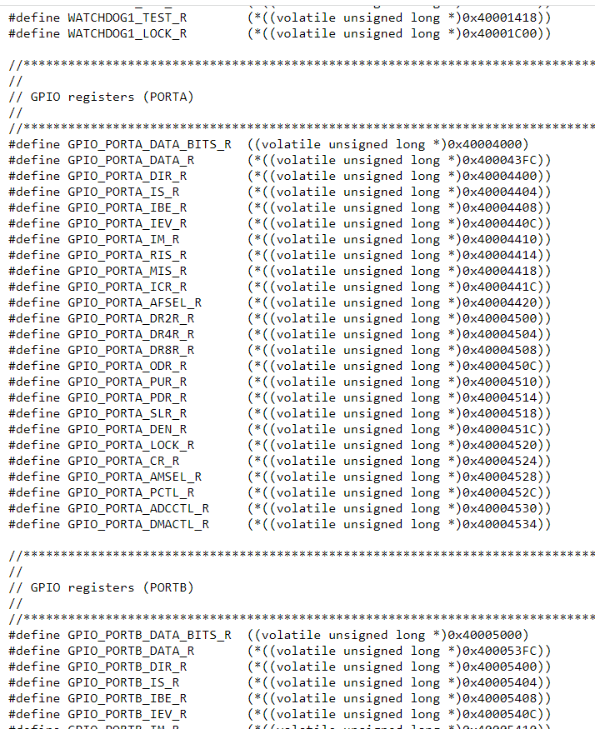
Include Header File
#include "TM4C123GH6PM.h"
Kshitij Hemant Gurjar (SY M.Tech VLSI)
Prof. Y.M. Vaidya
Swapnil Phalke (SY M.Tech VLSI)
MAP Lab

Slide 12
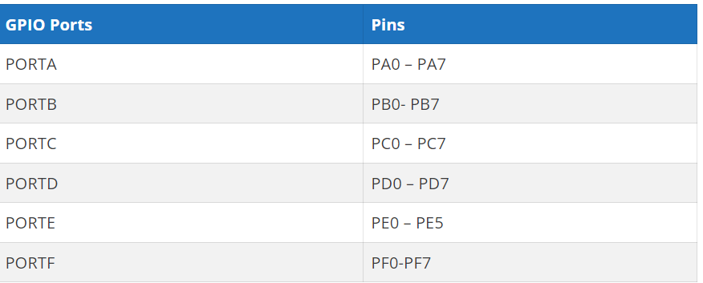
TM4C123GH6PM Microcontroller GPIO pins
TM4C123GH6PM belongs to the ARM Cortex M4 microcontroller series. It has six GPIO ports such as PORTA, PORTB, PORTC, PORTD, and PORTE. Each port has a different number of pins as given in this table.
LAB 1 Introduction to TM4C123
Kshitij Hemant Gurjar (SY M.Tech VLSI)
Prof. Y.M. Vaidya
Swapnil Phalke (SY M.Tech VLSI)
MAP Lab

Slide 13
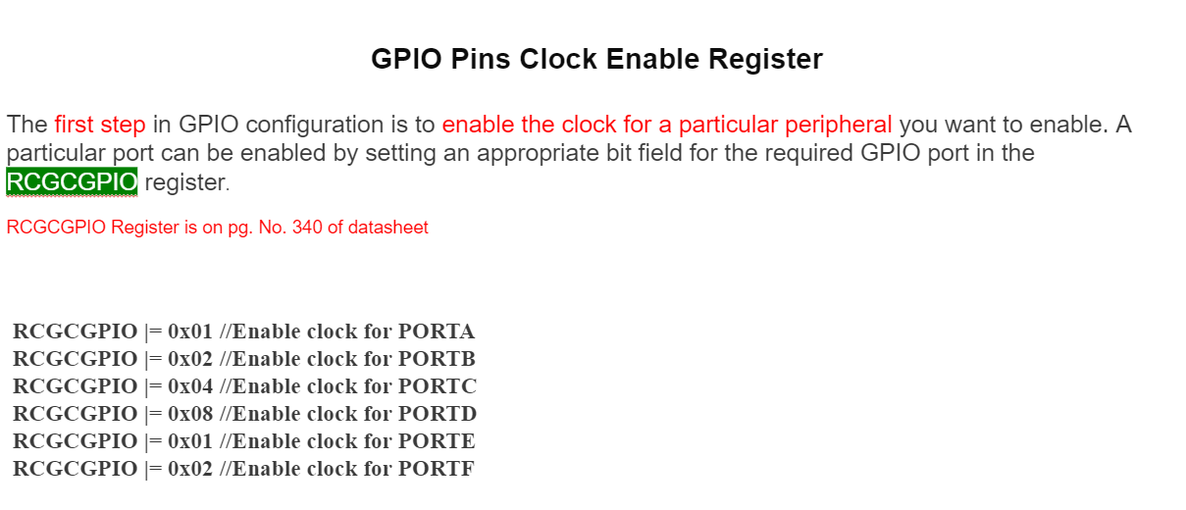
GPIO Pins Clock Enable Register
Kshitij Hemant Gurjar (SY M.Tech VLSI)
Prof. Y.M. Vaidya
Swapnil Phalke (SY M.Tech VLSI)
MAP Lab

Slide 14
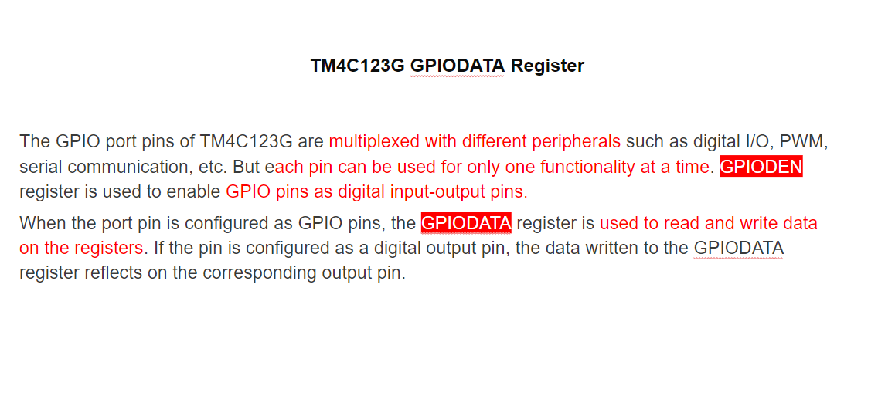
Kshitij Hemant Gurjar (SY M.Tech VLSI)
Prof. Y.M. Vaidya
Swapnil Phalke (SY M.Tech VLSI)
MAP Lab

Slide 15
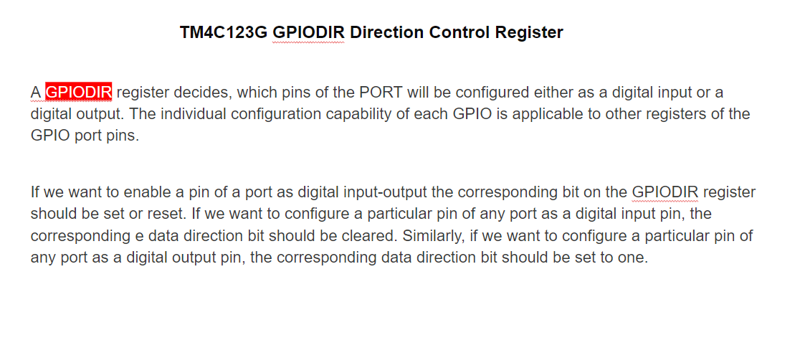
Kshitij Hemant Gurjar (SY M.Tech VLSI)
Prof. Y.M. Vaidya
Swapnil Phalke (SY M.Tech VLSI)
MAP Lab

Slide 16
GPIO Lock and Commit Registers
The next register is a GPIOLOCK register. It enables write access to GPIOCR register. In order to unlock access to the GPIOCR register, we must initialize the GPIOLOCK register with 0x4C4F.434B value.
Pull-Up Resistor Register
Because we will be using an internal pull-up register with a PF4 pin which will be used as a digital input pin. GPIOPUR register is used to enable or disable internal pull-up register with any GPIO pin. But to enable write to GPIOPUR, we first need to enable GPIOCR register. Otherwise, write operation to GPIOPUR register will not commit
Kshitij Hemant Gurjar (SY M.Tech VLSI)
Prof. Y.M. Vaidya
Swapnil Phalke (SY M.Tech VLSI)
MAP Lab

Slide 17
#define SYSCTL_RCGCGPIO_R (*(( volatile unsigned long *)0x400FE608 ) )
#define GPIO_PORTF_DATA_R (*(( volatile unsigned long *)0x40025038 ) )
#define GPIO_PORTF_DIR_R (*(( volatile unsigned long *)0x40025400 ) )
#define GPIO_PORTF_DEN_R (*(( volatile unsigned long *)0x4002551C ) )
int main ( void )
{
SYSCTL_RCGCGPIO_R |= 0x20; // Enable clock for PORTF
GPIO_PORTF_DEN_R = 0x0E; // Enable PORTF Pin1, 2 and 3 as a digital pins
GPIO_PORTF_DIR_R = 0x0E; // Configure ORTF Pin1, 2 and 3 digital output pins
while (1)
{
GPIO_PORTF_DATA_R |= 0x02; // turn on red LED
}
}
Kshitij Hemant Gurjar (SY M.Tech VLSI)
Prof. Y.M. Vaidya
Swapnil Phalke (SY M.Tech VLSI)
MAP Lab

Slide 18
#define SYSCTL_RCGCGPIO_R (*(( volatile unsigned long *)0x400FE608 ) )
Kshitij Hemant Gurjar (SY M.Tech VLSI)
Prof. Y.M. Vaidya
Swapnil Phalke (SY M.Tech VLSI)
MAP Lab

Slide 19
Assignment 2 :
Compute XOR from 1 to n
Input : n = 6
Output : 7
// 1 ^ 2 ^ 3 ^ 4 ^ 5 ^ 6 = 7
Input : n = 7
Output : 0
// 1 ^ 2 ^ 3 ^ 4 ^ 5 ^ 6 ^ 7 = 0
LAB 1 Introduction to TM4C123
Kshitij Hemant Gurjar (SY M.Tech VLSI)
Prof. Y.M. Vaidya
Swapnil Phalke (SY M.Tech VLSI)
MAP Lab

Slide 20
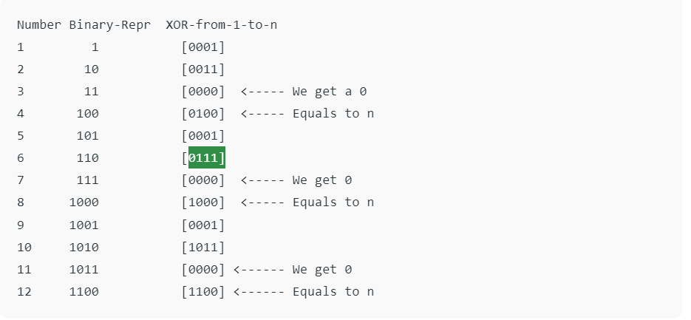
if (n % 4 == 0)
return n;
// If n%4 gives remainder 1
if (n % 4 == 1)
return 1;
// If n%4 gives remainder 2
if (n % 4 == 2)
return n + 1;
// If n%4 gives remainder 3
return 0;
Kshitij Hemant Gurjar (SY M.Tech VLSI)
Prof. Y.M. Vaidya
Swapnil Phalke (SY M.Tech VLSI)
MAP Lab

Slide 21
Assignment 3 :
What do you understand by Interrupt Latency?
Is it possible for a variable to be both volatile and const?
What is a reentrant function?
What are the reasons for Interrupt Latency and how to reduce it?
swap two numbers without using a temporary variable?
LAB 1 Introduction to TM4C123
Kshitij Hemant Gurjar (SY M.Tech VLSI)
Prof. Y.M. Vaidya
Swapnil Phalke (SY M.Tech VLSI)
MAP Lab

